Slide 2

Marius Sandbu @ Sopra Steria
Kubernetes and Security = True?
No its not, thanks for listening to my talk!
Warning: Content will most likely be outdated later today because of Kubecon North America

Slide 3
Where are we at?

Slide 4
<25000 Vulnerabilities reported in 2022
68 Average dependencies per application project
5 Average number of outstanding critical vulnerablities in an application
2 of 3 Cyberattacks in a cloud-native enviroment related to misconfiguration (or lack of)
97 Average number of days it takes to fix a vulnerability
0 Ransomware groups targeting Kubernetes (Only Windows Kubernetes, but who uses that anyways ?!?)
The State of Kubernetes Security in 2023 (redhat.com)

Slide 5
Attack vectors in a Cloud native platform
Vulnerabilities
Vulnerabilities in external/internal services
Misconfigured Services
Public exposed services
IT
DDoS-/DoS-attacks
TCP SYN Flood / HTTP GET/POST Flood
Teams / Slack
Email
Web
User information hiYescked
Credential Stuffing – MFA Fatigue
Phishing
Qbot / Icedid
Drive-by download
Malwarestealer - Tokens
Developers

Slide 6
The 4 C’s of Cloud Native Security
Unauthorized access to Kube API
Vulnerabilities in Kubernetes
What is going on inside here?!
Vulnerabilities in the code
Container Escape
Supply-chain vulnerabilities
Limited to none network «segmentation»
Code
Container
Limited RBAC
Credentials stored in plaintext in container
Cluster
Cloud Platform / Corporate Datacenter
Tactics - Threat Matrix for Kubernetes https://microsoft.github.io/Threat-Matrix-for-Kubernetes/

Slide 7
Kubernetes (k8s) Architecture
Some components
CSI = Storage and Secrets
Cloud Controller Manager = API integration to cloud providers
Kube API – Management API
Windows and Linux nodes
Many security mechanisms available from the cloud providers
Network integration called CNI
Example: Cilium, VMware NSX, Azure CNI
Load Balancer and Ingress
Service Mesh
Kubernetes Platform

Slide 8
Not all cyberattacks are that scary..
Kubernetes with Kubeflow
Kubeflow Pipeline
Using Kubeflow dashboard to trigger Tensorflow jobs
New pipeline→ Docker Images from Docker Hub
Kubeflow dashboard open to internet using default load balancer
XMRig for CPU Mining
Ethminer for GPU mining
Securing Azure Kubernetes Services - msandbu.org

Slide 9
Compromised Git pipeline
Developer X got his access token from Github stolen
Collected all enviroment variables in git and sent it to a digital ocean VPS
Tried to logon to Azure Portal using harvested credentials
Day 3 03:23 (sunday)
Day 1 04:20
04:37
01
02
03
04
05
06
Day 1 05:34 (Friday)
04:21
Attacker modified Actions workflow
Accessed storage account in Azure
Was able to collect «some» data

Slide 10
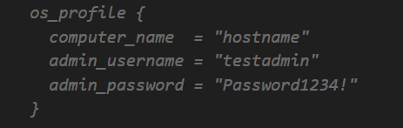
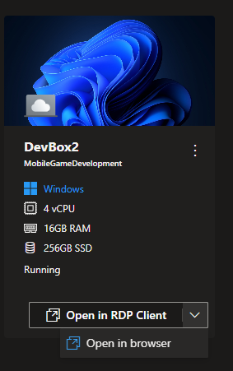
Securing the workbench
Be careful with Copilot
Visual Studio Code
GitPod
Github Codespaces
Provides a dynamic IDE via Browser
Can also use central iDP
Virtual Desktop
For development not supported locally or web based
Or..security requirements
Provide a VDI that provides direct access to internal resources

Slide 11
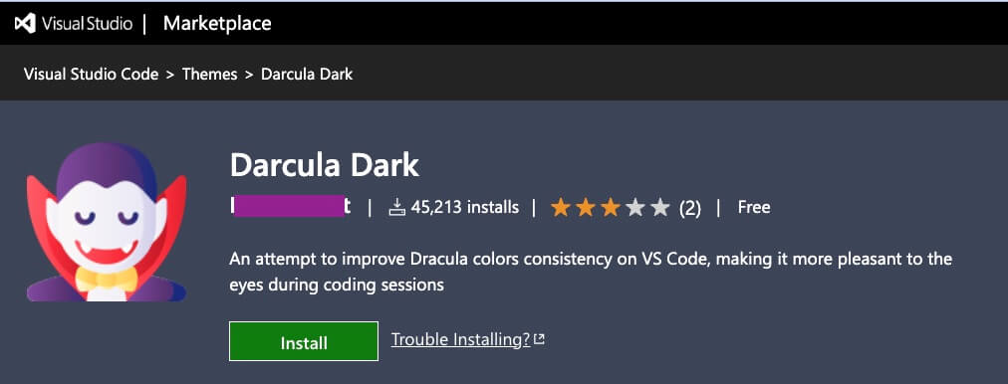
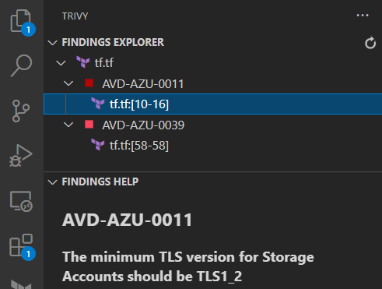
Securing the workbench
Stealing PII data
Be careful with use of extensions
Look for known/popular extensions
Look for approved publishers
Extensions for Code Scanning
Checkov
Trivy
Tfsec
Snyk
KICS (Checkmarx)
Understand risk before pushing in changes

Slide 12
Zero-Trust Network Access (SSE/SASE)
Identity Posture
Developer Ecosystem
Never Trust Always Verify
Device Posture
ZTNA Magic
CI/CD
Source Code
Automation
Web Apps
Jumphost
End-user
Condition based access
Lokasjon
Tidspunkt
Data
Session

Slide 13
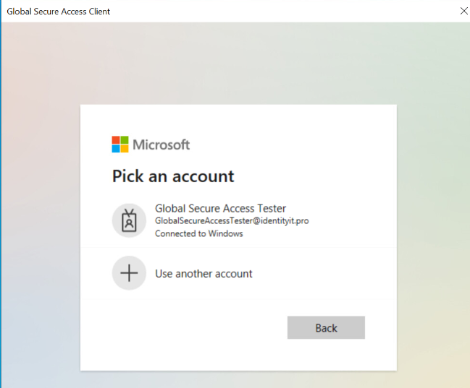
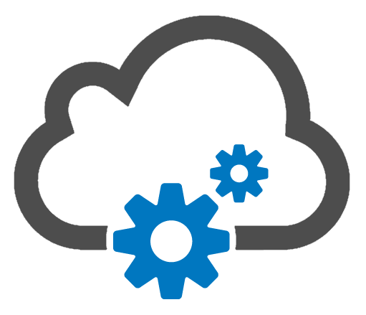
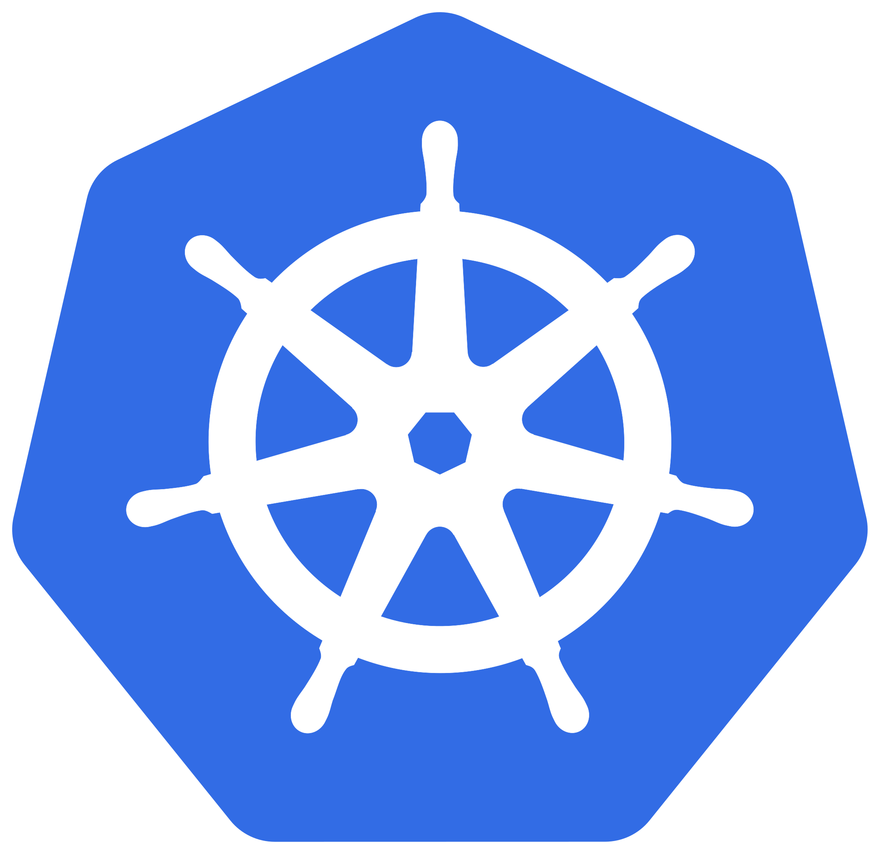
Secure Access and Secure publishing
Web Services
End-User w/ZTNA Agent
Kubernetes API
Internal virtual network
Some options: Teleport, Cloudflare & Microsoft

Slide 14
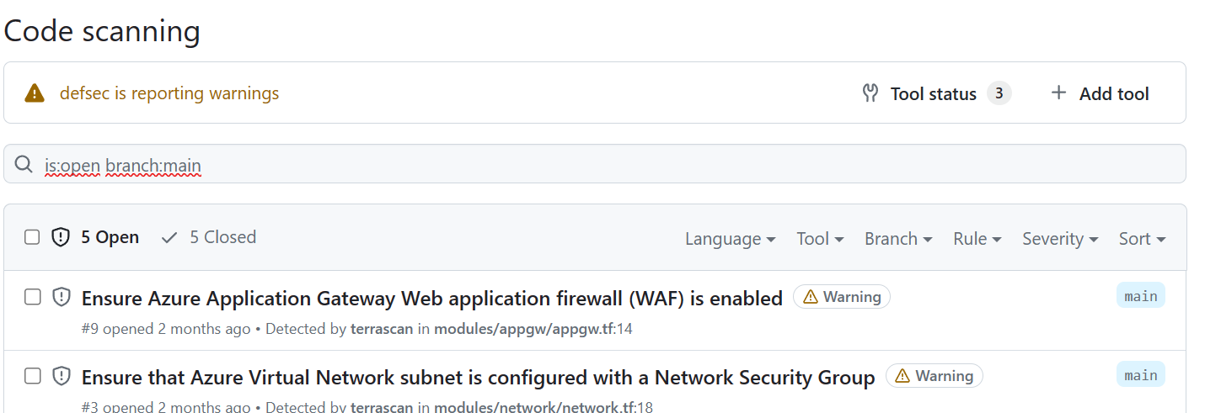
Security mechanisms for source code - Github
SCIM - User provisioning
SSO - with access control using SAML/OAuth
Self-hosted runners and private repos
Azure private networking for GitHub-hosted runners (In preview)
Trivy – Inspect Security in Containers and TF
Git Signed Commit
Github Advanced Security
Secret scanning = Free Services
Sarif support requires a license
Github Advanced Security: (features for private repos)
Code scanning
Secret Scanning
Depedency Review

Slide 15
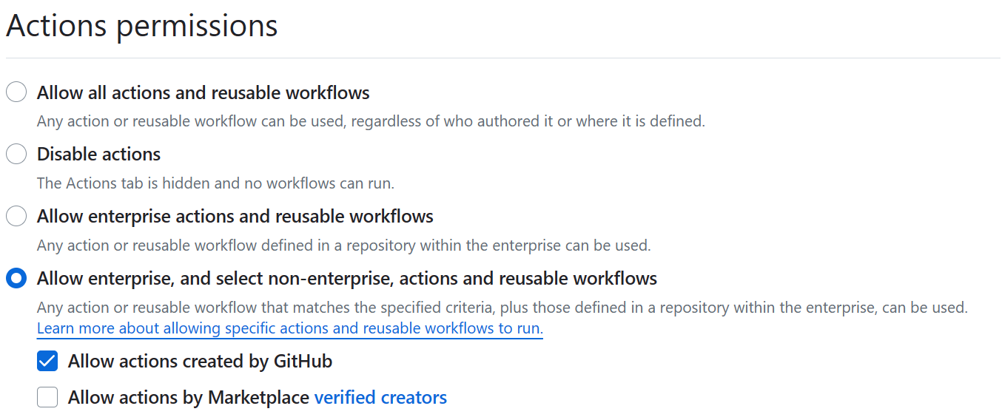
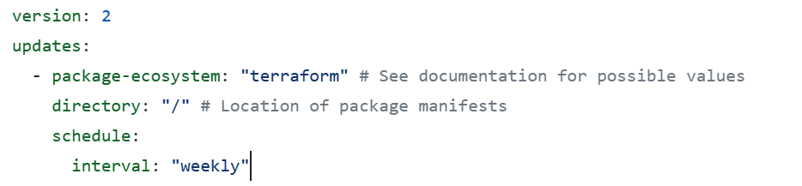
Securing the pipeline
API Access to Source Code
Start using fine-grained password tokens
Can be defined standard on a organization level
Federated Access to Cloud Provider
Or use secrets...
ARM_USE_OIDC: true
Codeowners
Assigns ownership to code
Maintain 3.party Github Actions
How a workflow can be structured
Good approval process

Slide 16
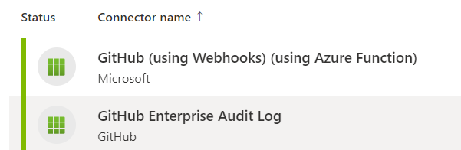
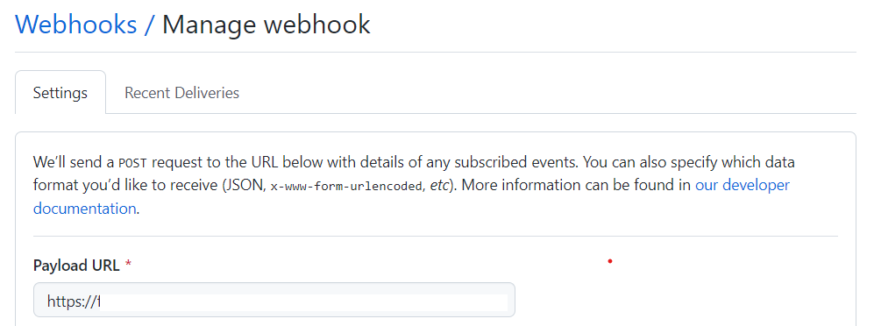
Security mechanisms for GitHub
Github with Webhooks (Collects logs from Actions, Forks, Code Scanning) sends to an Azure Function)
Security Monitoring with Azure Sentinel
Github Enterprise Audit Log (Collects information about use admin activity and nothing related to Actions)

Slide 17
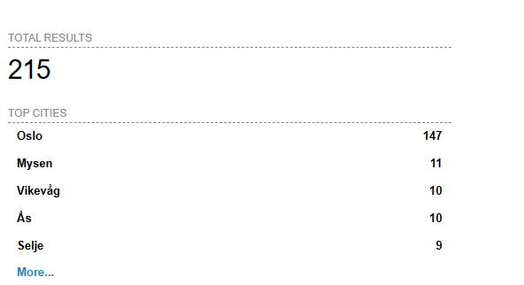
Use of Private Clusters
No option to «block» authentication attempts
Mostly a challenge related to public cloud Kubernetes
Reduce the «abuse» of tokens against KubeAPI
Some known vulnerabilities (CVE-2022-3172)
Approved IP Ranges
Lock down and use other means to connect
Shodan Product:Kubernetes Country:”NO”

Slide 18
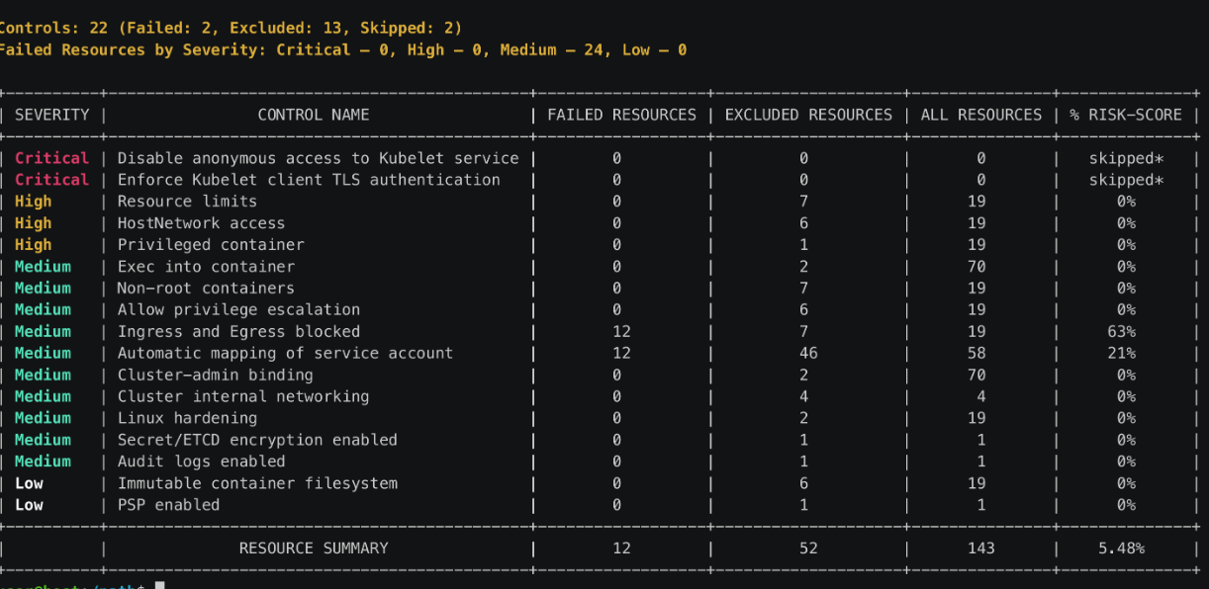
Is the Cluster according to best pratices?
Kubebench – Scans according to CIS
Kubescape – Scans according to NSA-CISA, CIS
Or «commercial edition»
Both understand which platform they are on
Can be run interactively
or as part of a workflow
YAML and JSON

Slide 19
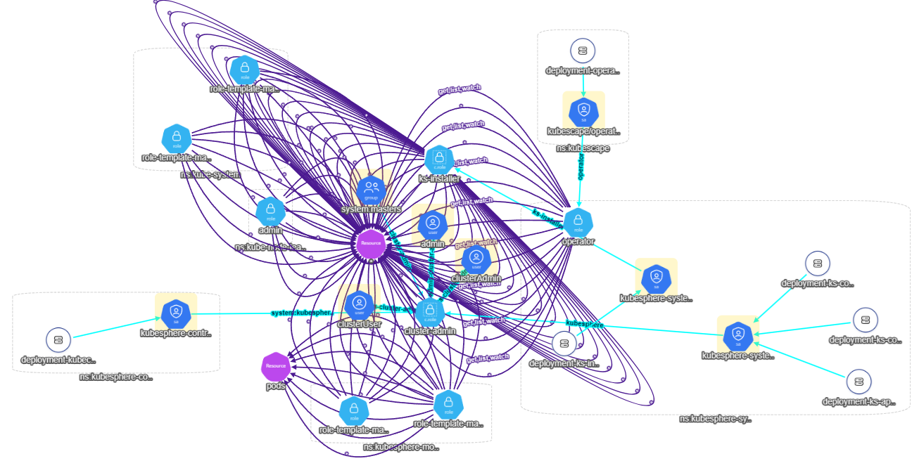
IAM and RBAC
Authentication against KubeAPI with either
Token, Certificate or Authentication proxy
Certificates in K8s cannot be rewoked
No built-in support for LDAP
RBAC is used to add access not deny
Roles and permissions on Cluster or namespace
RBAC and API Objects All permissions can be delegated(CRUD)
apiVersion: rbac.authorization.k8s.io/v1 kind: Role metadata: namespace: default name: pod-reader rules: - apiGroups: [""] # "" resources: ["pods"] verbs: ["get", "watch", "list"]
apiVersion: rbac.authorization.k8s.io/v1 kind: RoleBinding metadata: name: read-pods namespace: default subjects: - kind: User name: minikube apiGroup: rbac.authorization.k8s.io roleRef: kind: Role name: pod-reader apiGroup: rbac.authorization.k8s.io
Role
Rolebinding
Namespace
ClusterRole
ClusterRoleBinding
rbac-tool

Slide 20
Workload Identity and OpenID Connect
Secure authentication from container to PaaS service with exposing secrets
Currently supported by Microsoft and Google
Can be used from a Kubernetes cluster running «anywhere»
Federated authentication using OpenID Connect
Avoid the use of keys! Use a managed identity instead!

Slide 21
Pod Security Admission (PSA)
To have better isolation on Pods
3 built-in levels
Ex: Privileged gives no limits
Start with restricted as default
Can also be managed by Kyverno
warn
audit
enforce
Policy Modes
Namespace
kubectl label --overwrite ns test-privileged pod-security.kubernetes.io/enforce=privileged pod-security.kubernetes.io/warn=privileged
kubectl label --overwrite ns test-restricted pod-security.kubernetes.io/enforce=restricted pod-security.kubernetes.io/warn=restricted
Pod Security Standards
restricted
privileged
baseline

Slide 22
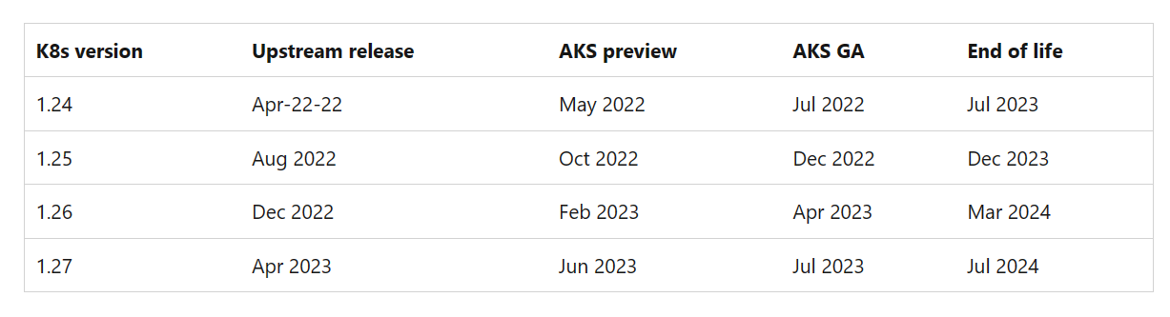
Upgrades and patching
1 year active support on a minor release
Long-term support options now available Kubernetes patches often come weekly Worker and master nodes OS patches Many updates require a restart Slightly dependent on underlying OS Ex: VMware - Photon, Microsoft - Mariner Kured (Kubernetes Reboot Daemon) Looks for /var/run/reboot-required and reboots if needed
Canonical and Microsoft supports Guest Patching Services
Get warning about unsupported API´s
FairwindsOps/pluto
Upgrade Azure Kubernetes Service using Terraform - msandbu.org

Slide 23
Backup and data protection
For services that require persistent storage
Provisions using built-in CSI (storage interface)
Cloud platforms, Dell, HP, NetApp, IBM etc
For data storage that requires read/write by multiple pods.
Backup is something that needs to be deployed seperately
Use of tools like Velero, Kasten or Portvorx
Or native AKS backup in preview (Velero in-disguise)
Uses the built-in CSI Snapshot provider to do backup
Kubestr can be used to benchmark CSI drivers and storage performance

Slide 24
Backup and data protection
apiVersion: storage.k8s.io/v1 kind: StorageClass metadata: name: managed-csi-secure
provisioner: disk.csi.azure.com
parameters:
skuName: StandardSSD_LRS networkAccessPolicy: DenyAll reclaimPolicy: Delete volumeBindingMode: WaitForFirstConsumer allowVolumeExpansion: true
Ensures that CSI provisioned drives cannot be exported directly from Azure

Slide 25
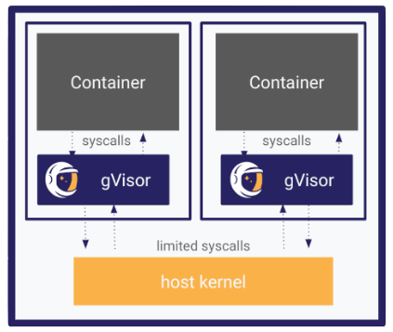
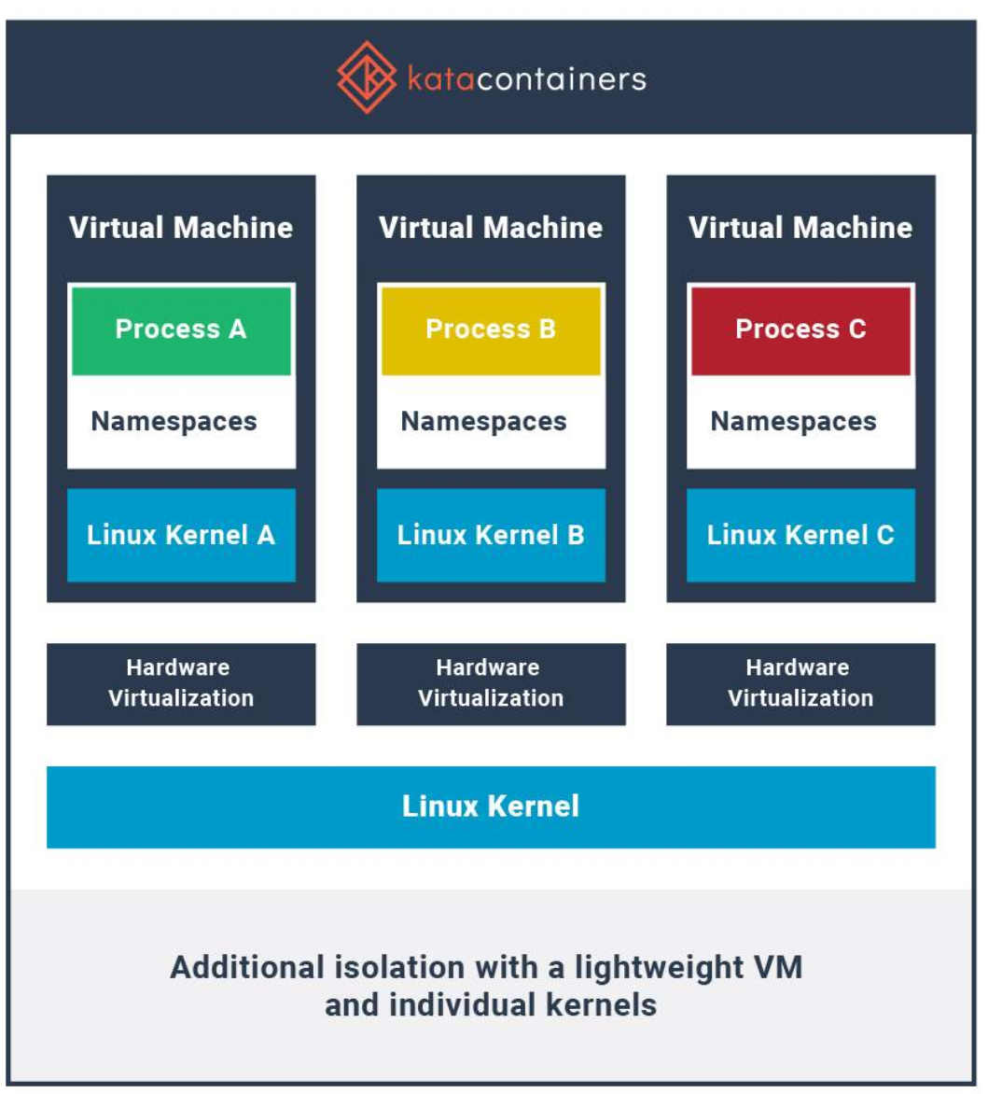
Encryption and Container Isolation
gVisor
Kata Containers
Emulates OS syscall via Go APIs
Each container its own lightweight VM (in preview AKS)

Slide 26
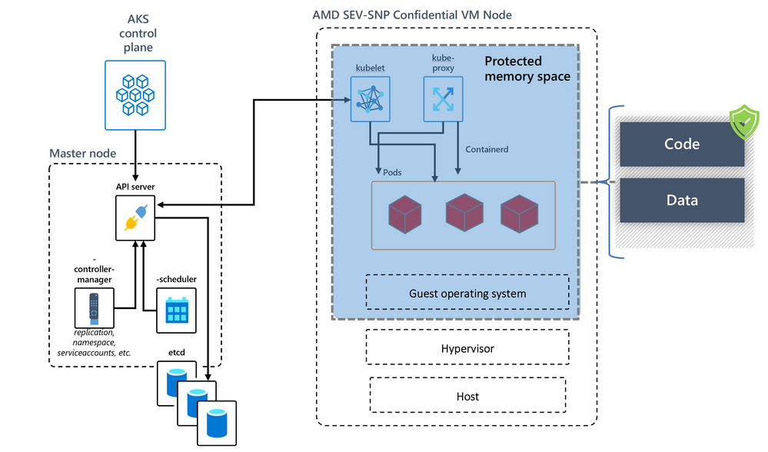
Encryption and Container Isolation
Confidental Computing Available Azure and GCP
Uses AMD SEV CPU Feature to encrypt running memory and CPU

Slide 27
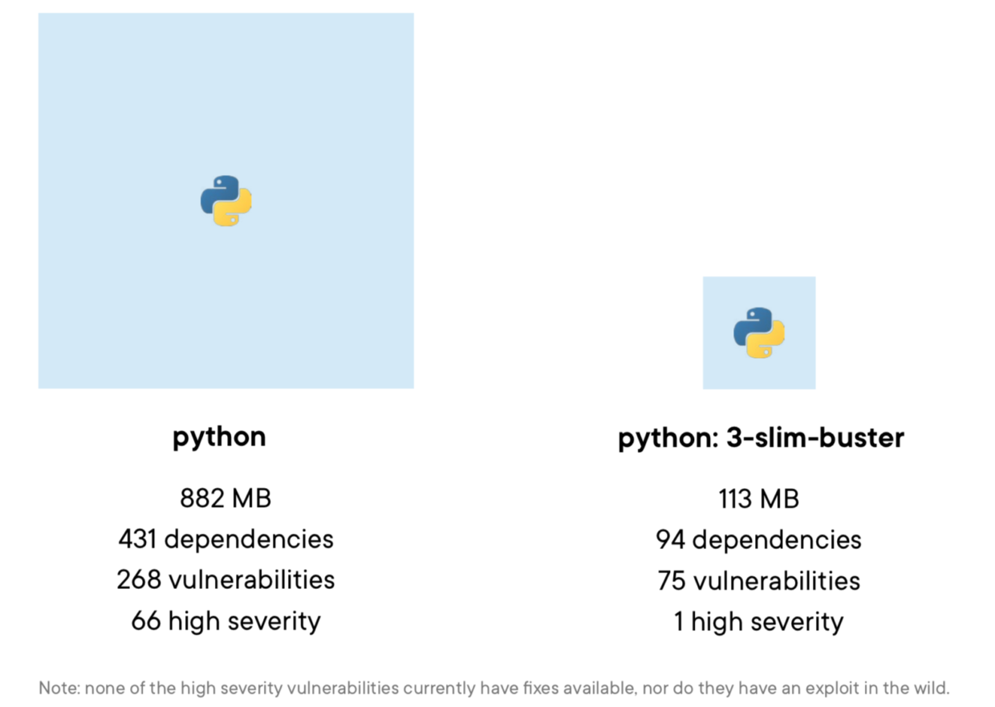
Container Registry
Many are using base image with heavy footprint
Small changes required such as just changing to slim
Private vs Public Image repository
Same principles apply in regard to access control
Only allow «approved» images
Image scanning mechanisms to detect vulnerabilities
Azure Defender for Containers
Microsoft Copacetic
Parses updates from vulnerability reports, adaptable to various formats.
Processes updates with package managers, extendable for more tools.
Applies updates to container images via buildkit.

Slide 28
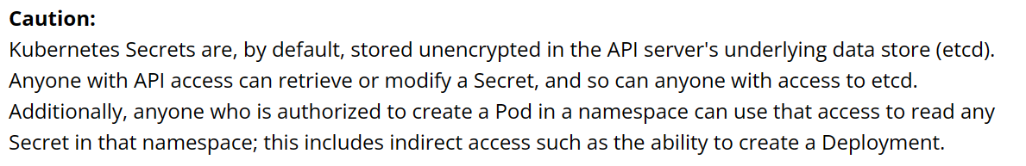
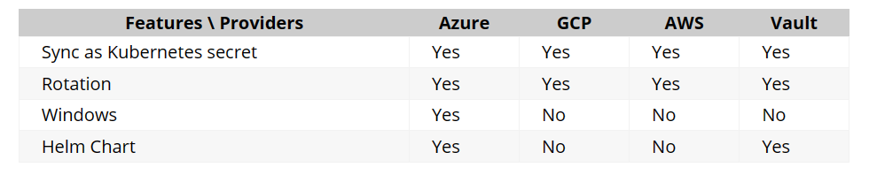
Secret management
Etcd has no built-in versioning Data is not encrypted At-Rest Recommendation is either Secret Store CSI Driver or Kubernetes External Secret Operator External Secret Provider syncs secrets out of Kubernetes environment
Supported for Secret Store CSI

Slide 29
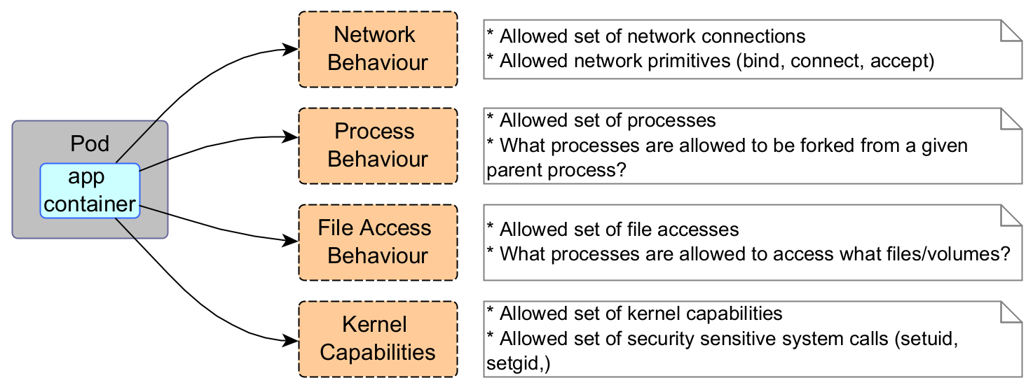
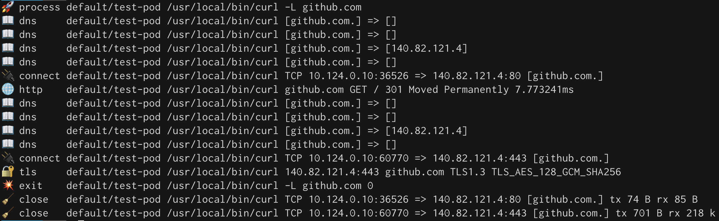
What is going on inside the container?
Falco + Falcosidekick (Audit + Visibility) Tracee (Audit + Visibility) Tetragon (Audit + Visibility) KubeArmor (Audit + Protection) Everyone uses eBFP KubeArmor can e.g. automatically generate network policies Based on traffic visibility (depending on the right CNI)
Example with Tetragon

Slide 30
Network Policies
apiVersion: networking.k8s.io/v1
kind: NetworkPolicy
metadata:
name: frontend-to-sqldatabase
namespace: default
spec:
podSelector:
matchLabels:
app: sqldatabase
policyTypes:
- Ingress
- Egress
ingress:
- from:
- ipBlock:
cidr: 172.17.0.0/16
- namespaceSelector:
matchLabels:
project: myproject
- podSelector:
matchLabels:
role: frontend
egress:
- to:
- ipBlock:
cidr: 10.0.0.0/24
ports:
- protocol: TCP
port: 5978
Enables traffic management at layers 3 and 4 IP, Port, Protocol, Pod label By default: In Kubernetes, everything is opened Requires a network CNI that can control the rules Calico, WeaveNet, Azure CNI, GKE CNI, Cilium (eBFP)
Pros / cons with most CNI offerings Start with a deny-all rule Management of rules via YAML Config
Destination
Source IP
Source
Target IP and Port
Some free tools for easy visualization https://orca.tufin.io/netpol/
https://artturik.github.io/network-policy-viewer/

Slide 31
Service Mesh
Is a platform able to provide
Visibility Security Traffic management
Moving management of this to the platform
Removing the need to handle this on a application level
Control Plane
Service 1
Service 2
With mTLS
Sidecar proxy
Sidecar proxy

Slide 32
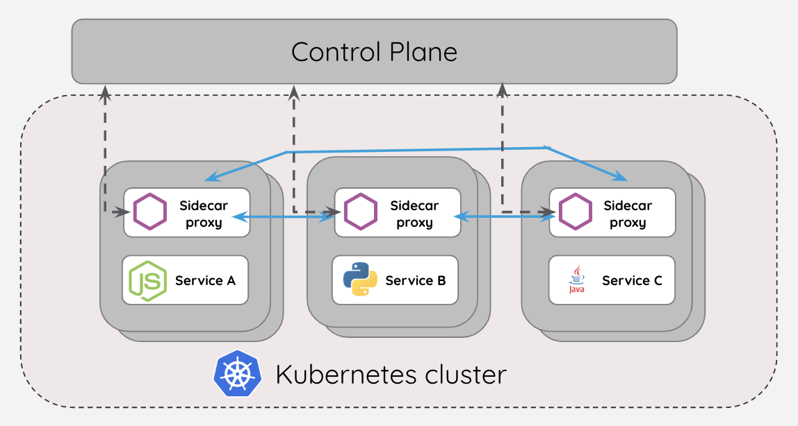
Service Mesh - Architecture
Different functionality and approach from vendor to vendor Sidecar proxy or using eBFP Cilium uses eBFP Istio uses iptables mTLS on services that support it Visibility into network flow Allows for layer 7 management Being replaced now with new architecture

Slide 33
Service Mesh vs Network Policies
Linkerd Policy
Azure CNI Policies
apiVersion: policy.linkerd.io/v1beta1
kind: HTTPRoute
metadata:
name: authors-get-route
namespace: frontend
spec:
parentRefs:
-name: authors-server
kind: Server
group: policy.linkerd.io
rules:
- Matches:
- path:
value: "/cms/"
type: "PathPrefix"
method: GET
apiVersion: networking.k8s.io/v1
kind: NetworkPolicy
metadata:
name: demo-policy
namespace: frontend
spec:
podSelector:
matchLabels:
app: server
ingress:
- from:
- podSelector:
matchLabels:
app: client
- ports:
- port: 80
protocol: TCP

Slide 34
Some alternatives
Features | Istio | Linkerd | Hashicorp Consul | Traefik Mesh | Kuma (from Kong) | Cilium | VMware Tanzu
Proxy gateway | Envoy | Linkerd2-proxy | Envoy | Own | Envoy | eBFP | Envoy
Sidecar Proxy | Yes | Yes | Yes | No | Yes | Both | Yes
Container-VM | Yes | No | Yes | No | Yes | Yes | No
MultiCluster | Yes | Yes | Yes | No | Yes | Yes | Yes
BYO Ingress | Gateway | Yes | Yes | TYes | Yes | Yes | Yes
Dashboard | Kiali | Yes | Yes | Traefik Hub |  | Hubble | Tanzu Mission Control
mTLS | Yes | Yes | Yes | Yes | Yes | Yes | Yes
Traffic Control | Yes | Yes | Yes | Yes | Yes | Yes | Yes
HTTP/3 | Yes | No | Yes | Yes | Yes | Yes | Yes
https://linkerd.devstats.cncf.io/

Slide 35
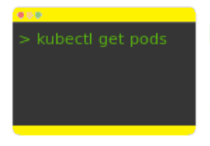

Security Monitoring
Kubectl apply -f
Kubernetes API monitoring
Kubernetes Audit Policy
DNS Logs from CoreDNS
apiVersion: audit.k8s.io/v1 kind: Policy omitStages: - "RequestReceived" rules: - level: RequestResponse resources: - group: "" resources: ["pods"] - level: Metadata resources: - group: "" resources: ["pods/log", "pods/status"]
Audit Level
Log Service
Host logs
None
Metadata
Request
RequestResponse
Splunk
Sentinel
ELK
Loki
CNI logger

Slide 36
Some Commercial alternatives
Snyk
SonarCube
AquaSecurity
Sysdig
Secure code development Secure dependencies Container image scanning for vulnerabilities Secure IaC encoding
Secure code development Secure IaC encoding
Cloud and Kubernetes Security Posture Secure code development Securing Pipeline Secure IaC encoding Vulnerability Management Container image scanning for vulnerabilities
Secure IaC coding Vulnerability Management Container image scanning for vulnerabilities Cloud and Kubernetes Security Posture

Slide 37
Let dig into the fun stuff!

Slide 38
Where to start? Depending on maturity
Basic level
Next level
Use-case dependant
Private Cluster
iDP based access
Security monitoring in code, containers and dependencies
Nettverk Policies
Access Control
Patch and update Management
Workload Identity
Security Monitoring
External Secret Management
Network Policies
Access using Zero-Trust
GitOps
Identity Management using SCIM
Service Mesh
Backup
gVisor or confidental computing
Falco or Tetragon eBFP
Other commercial options

Slide 39
Marius Sandbu @ Sopra Steria
Kubernetes and Security = True?
Questions? Come find me!

